Slide 1
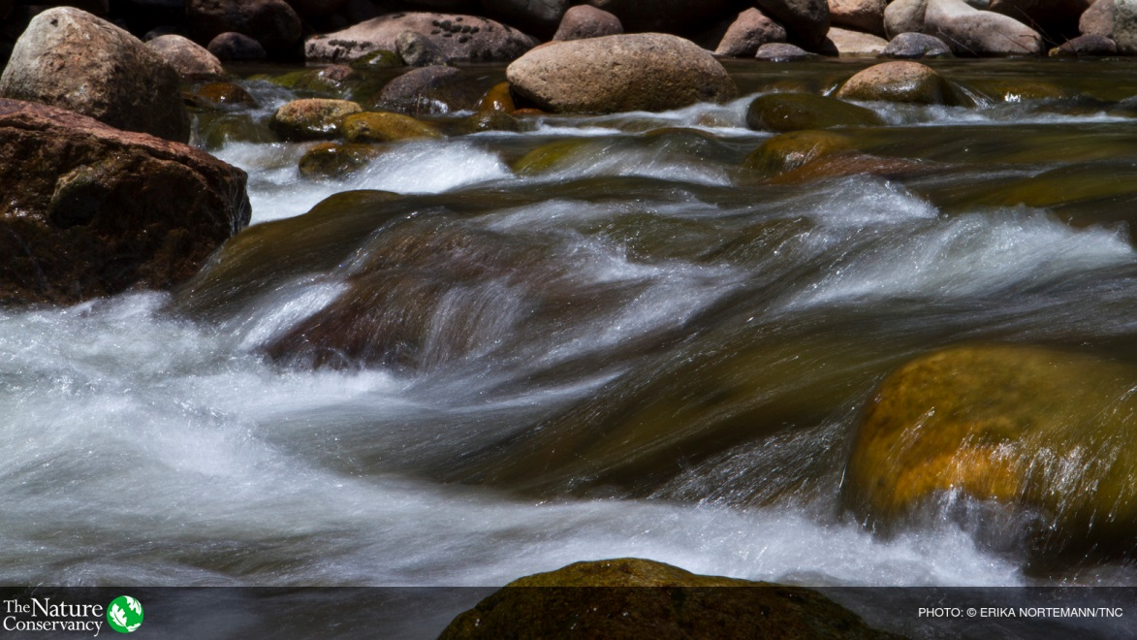
Anthony Kariuki
General Manger, Upper Tana Nairobi Water Fund

Slide 2
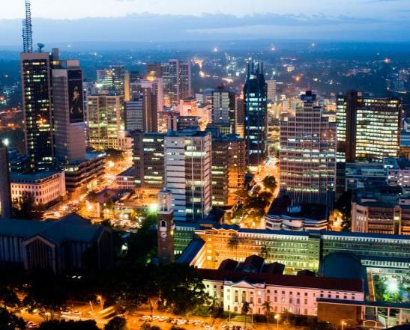
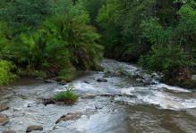
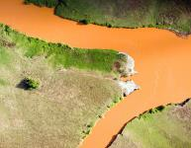
THE TANA WATERSHED
65%
OF KENYA’S HYDROPOWER
95% +
OF CITY DRINKING WATER
9 MILLION PEOPLE
Notes:
Photos © Thomas Cockrem / Alamy Stock Photo, The Africa Image Library / Alamy Stock Photo, National Geographic Creative / Alamy Stock Photo and Nature Picture Library / Alamy Stock Photo (from top to bottom, counter clockwise)

Slide 3
Nairobi is Water Scarce
30% higher demand in city than supply
20-year projected delay in meeting ‘current’ demand
60% of city residents experience water shortages
© Roshni Lodhia
Notes:
Use Arial for header and Chronicle/Georgia for body. Header in Arial Bold. Always credit pictures Photo: (Name of Photographer)

Slide 4
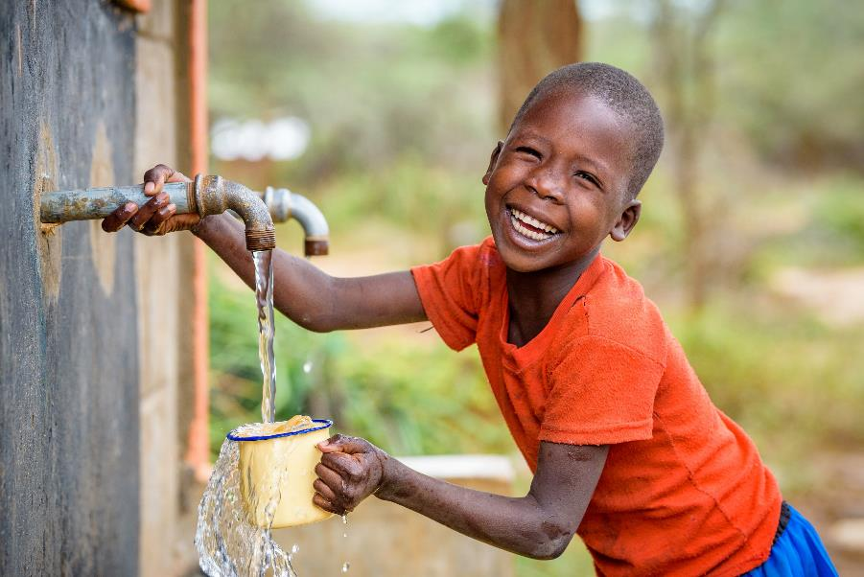
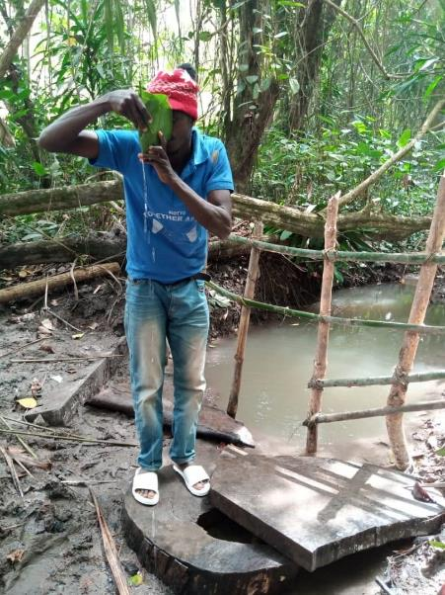
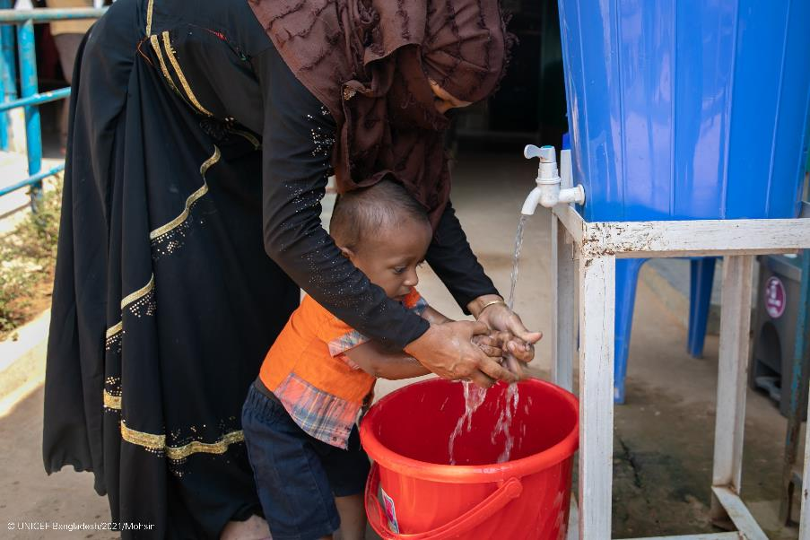
Main Challenges
Unreliable water
Inadequate wastewater system
Low sewer coverage
Athi Water Works Driving Some Good Effort
Kshs 124 billion needed for sewer
Land earmarked under alternative use
Not a great political give-away
Sunk a few wells to augment severe shortage

Slide 5
2011- 2021 Journey
2011 Scoping study
2012 Feasibility study
2013 High level stakeholder's exposure tour, MoUs
2014 Design study
2014 Proof of concept activities
2015 Business Case launch
2016 Trust deed established
2016 BoT, BoM established
2016 Trust staffed
2016-2021 Trust managed by TNC under contract
2018 Endowment account established
2021 Trust granted full independence, autonomy

Slide 6
From Top to Tap
Notes:
CHALLENGE: Soil from 300,000 small-scale farms is washing into the Tana River, resulting in dirty water, disruption of water supply, loss of farm productivity, loss of income, expansion into wildlife habitat, etc.
OPPORTUNITY: TNC worked with partners to create a Water Fund, a globally proven model that brings people together to harness the power of nature conservation to solve water challenges.
GOALS (benefits) of the Upper Tana-Nairobi Water Fund are 3Cs - Clean Water: Community Benefits: Conserve Nature
STRATEGY - fix farms and forests: We aim to plant 2 million trees and to work with 50,000 farmers on steep
slopes by:

Slide 7
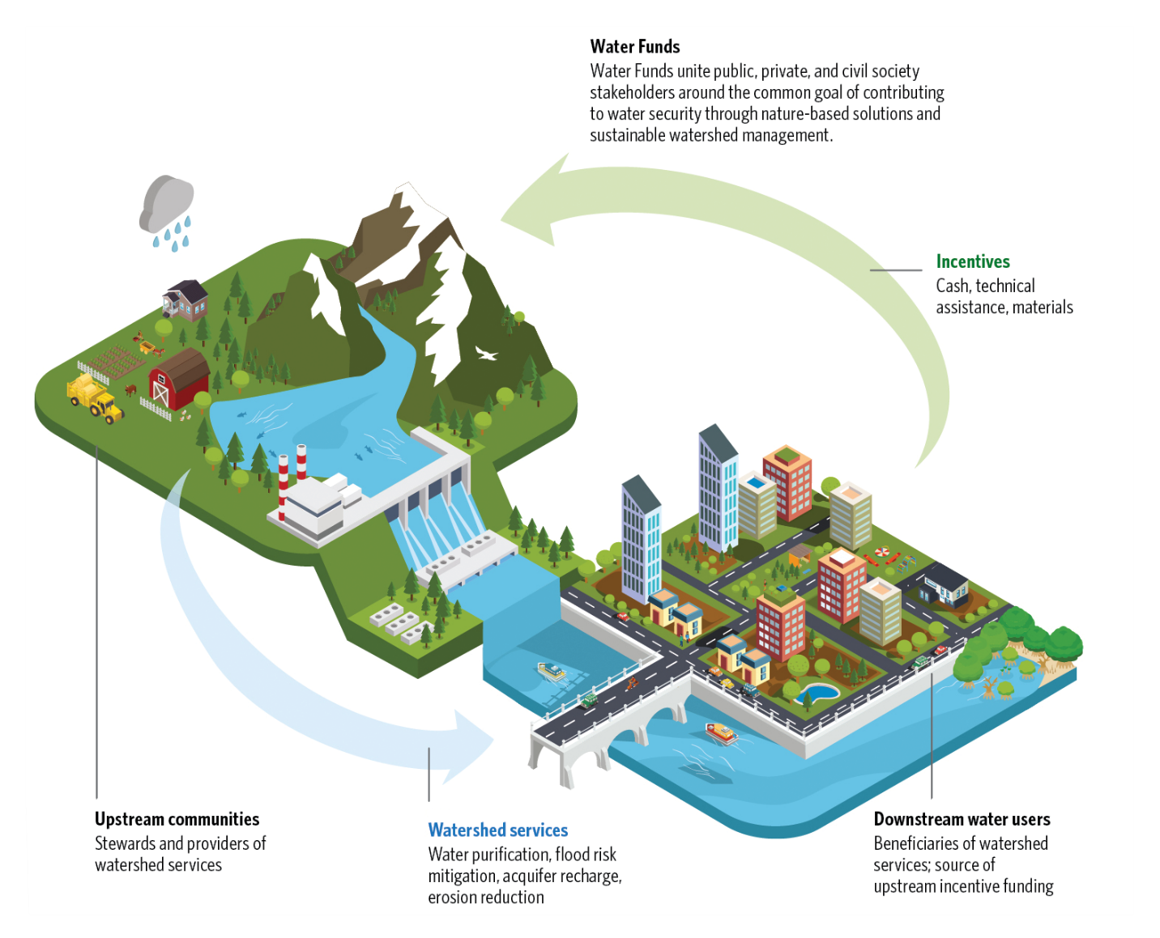

Slide 8
Notes:
Endowment growth and interest slower in 2020
Endowment interest to catch up by 2023
From 2022, include more leverage funding by counties et al

Slide 9
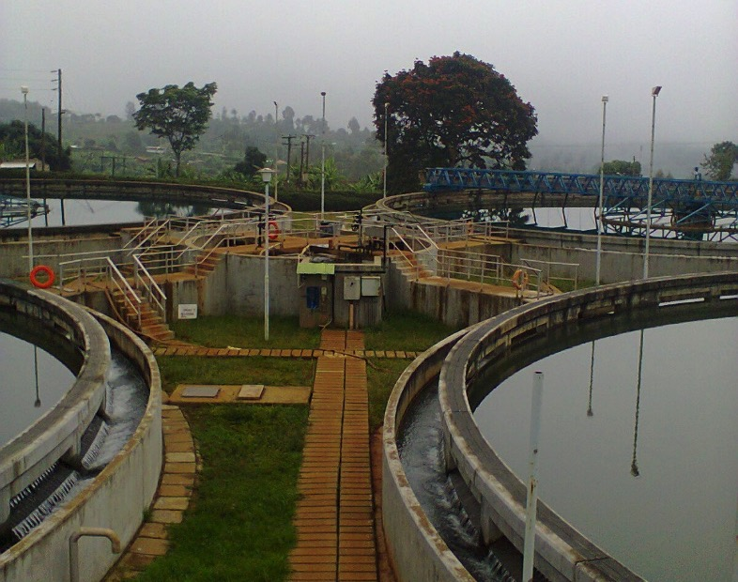
IMPACTS | Business
Current Supply and Demand
720 million liters/ day- Demand
552 million liters per day- Supply
60% of population experience shortage
Current Efforts
27 million liters from conservation- 2018
142 million litres from Northern collector corridor- 2022
NICK HALL
AMI VITALE
AMI VITALE
Notes:
Totally makes business sense
Increased annual revenue for KenGen Us$600,000 – more water flowing to Masinga dam, less sediments into the dam
Coast savings by NCWSC of approx. US$250,00 annually due to less treatment costs, lower energy costs, cleaner water hence more water supplied to the city residence and no shutdowns

Slide 10
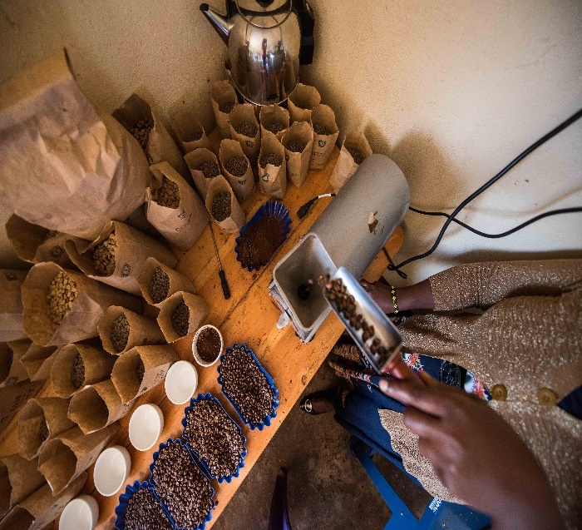
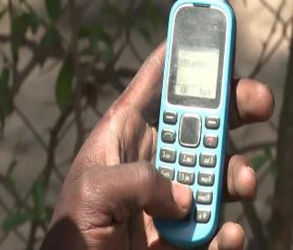
Benefits and Impact to Farmers
More than 28,000 farmers are applying soil conservation and water-saving methods
Over US$3 million per year in increased agricultural yields for smallholders and ag producers
8,500 coffee farmers are certified for Rainforest Alliance. 40% yield rise with good ag practices
More than 35,000 farmers are enrolled in a mobile data monitoring & extension platform.
© Roshni Lodhia
© Roshni Lodhia
© Roshni Lodhia
© TNC Staff
Notes:
Use Arial for header and Chronicle/Georgia for body. Header in Arial Bold. Always credit pictures Photo: (Name of Photographer)

Slide 11
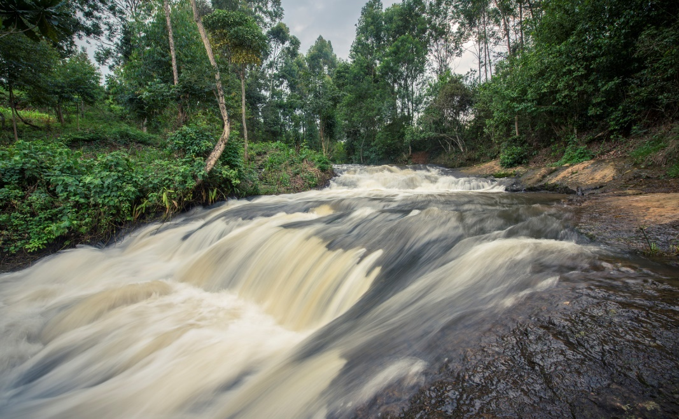
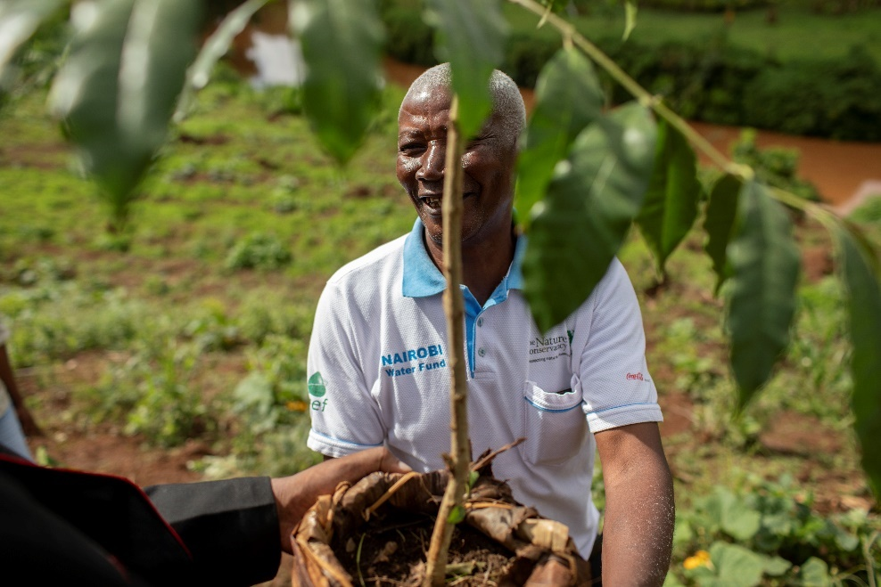
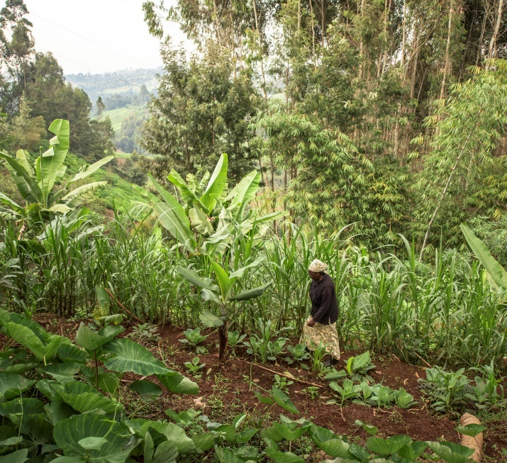
Benefits and Impact on Land & Water
27 million more liters of water flowing into Nairobi each day
Over 50% reduction in sediment concentration in rivers
Over 2.8 million new trees growing in the watershed. Over 500 ha of forest rehabilitated
196,000 acres of land put under sustainable management
© Michael North
© Bobby Neptune
© Roshni Lodhia
Notes:
Use Arial for header and Chronicle/Georgia for body. Header in Arial Bold. Always credit pictures Photo: (Name of Photographer)

Slide 12
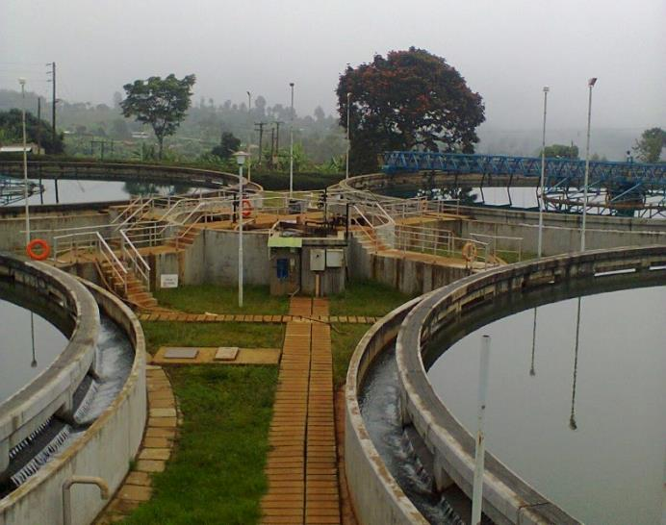
Benefits & Impact on Business
More clean water flowing to hydropower dams is helping prolong life of dams and generating equipment
Cleaner water from rivers reduced costs of treating water for cities and business. Reduces supply interruptions
© Nairobi Water
NICK HALL
AMI VITALE
Notes:
Use Arial for header and Chronicle/Georgia for body. Header in Arial Bold. Always credit pictures Photo: (Name of Photographer)

Slide 13
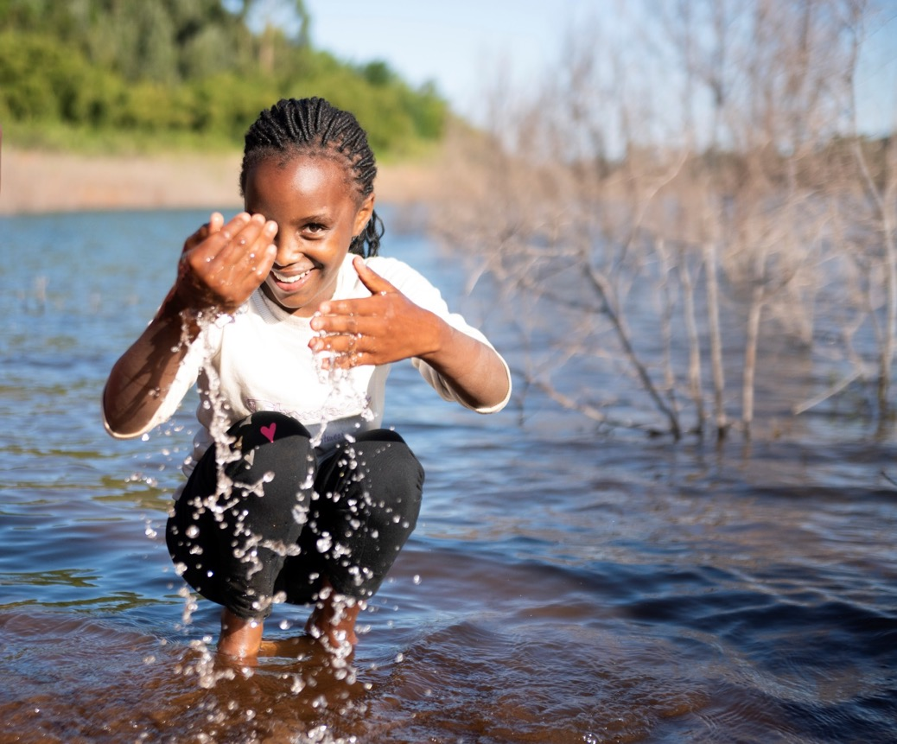
Put a project picture here
Thank you

