Slide 1
Geneva Cities Hub – 3rd Geneva Urban Debate
Post-COVID Economic & Financial Recovery: What about the City?
“Building Urban Economic Resilience during and after COVID-19”
UNDA COVID-19 RAPID RESPONSE
28 June 2021

Slide 2
Urban Resilience Diagnostic Tool - Overview
RA1: Resilience of local business environment
RA2: Resilience of local labour market
RA3: Resilience of local financial system
RA4: Resilience of economic governance
RA5: Resilience of basic service infrastructure
Notes:
As part of the UNDA 13th tranche project “Building Urban Economic Resilience during and after COVID-19”, UNCDF has prepared a concept note conceptualizing urban economic resilience. This work has advanced a framework for urban economic resilience that is tailored towards responding to the COVID-19 pandemic. Urban Economic Resilience: A Concept Paper for the joint UN Project “Urban economic and financial recovery and resilience building in the time of COVID-19”.

Slide 3
Urban Resilience Diagnostic Tool – Structure and Products
Resilience diagnostic
Baseline city performance in relevant resilience areas based on a set of indicators
Economic Resilience Performance report
What is working well and what is not working
A. Understand baseline performance of city on urban economic resilience indicators
B. Inform planning activities to achieve desired improvements to identified areas
Identify areas that need improvement
Vision for economic recovery
Visioning Workshop
Priority areas for recovery/resilience building
Resilience planning
Develop actions to achieve the desired improvements
Economic Resilience Building Plan
What needs to be improved, by how much and how
Identify the relevant implementation arrangements

Slide 4
Urban Resilience Diagnostic Tool – Methodology
Extensive data collection and validation process
Official data used for all indicators where available
Experts Working Group
Topic area sub-groups
Multiple review workshops
City Authorities Validation
Constraints
Availability of official data
Availability of real-time data
Availability of disaggregated data
Indicators only one part of a more holistic view

Slide 5
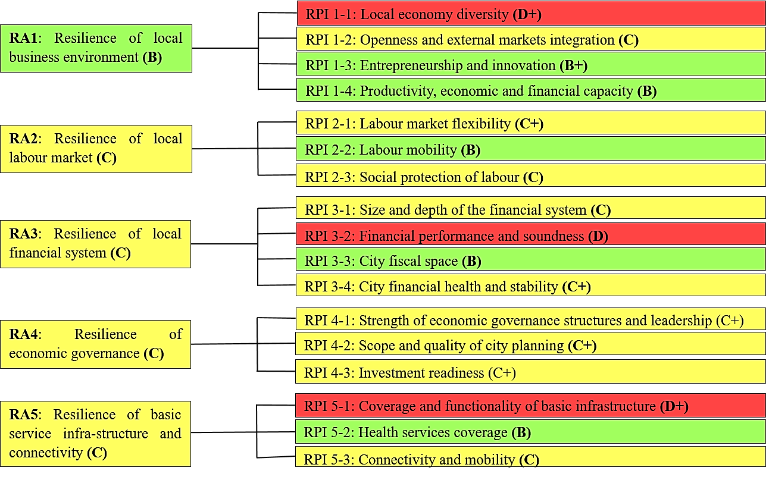
Urban Resilience Diagnostic Tool – Result City of Bishkek

Slide 6
Urban Resilience Diagnostic Tool – Draft Preliminary Findings
Based on the results of the diagnostics, it can be concluded that the city of Bishkek has five areas for the development of its policies to increase resilience to external influences such as the COVID-19 pandemic. This includes:
Improving city data collection, including through strengthening a partnership with the national statistical agency and other agencies which possess data on the city. Availability of urban data and statistics is critical to formulating an adequate response to the COVID-19 pandemic. Such a response will be essential for building the urban economic resilience and implementing the 2030 Agenda.
Promoting participatory approach to building urban resilience through strengthening engagement of civil society, local businesses and communities and involving them in urban economic resilience and recovery plans and decision making. Public consultation is important to improve public policy initiatives.
Local Government should ensure that COVID-19 pandemic recovery measures are focused on areas that can provide value creation for the community. Jobs creation and sustainable development of the City of Bishkek with tangible actions for building urban economic resilience against the socioeconomic impact of the pandemic and climate emergency are part of the problem and the solutions.
Companies and SMEs should continue to focus on retaining the core business; survival is essential.
Ensuring an integrated approach to building urban resilience: fully integrate key socio-economic, environmental, nature-based solutions and urban planning actions.

Slide 7
THANK YOU
urbaneconomicresilience.org
Building Urban Economic Resilience during and after COVID-19
Geneva Cities Hub – 3rd Geneva Urban Debate
Post-COVID Economic & Financial Recovery: What about the City?
28 June 2021

