Slide 1
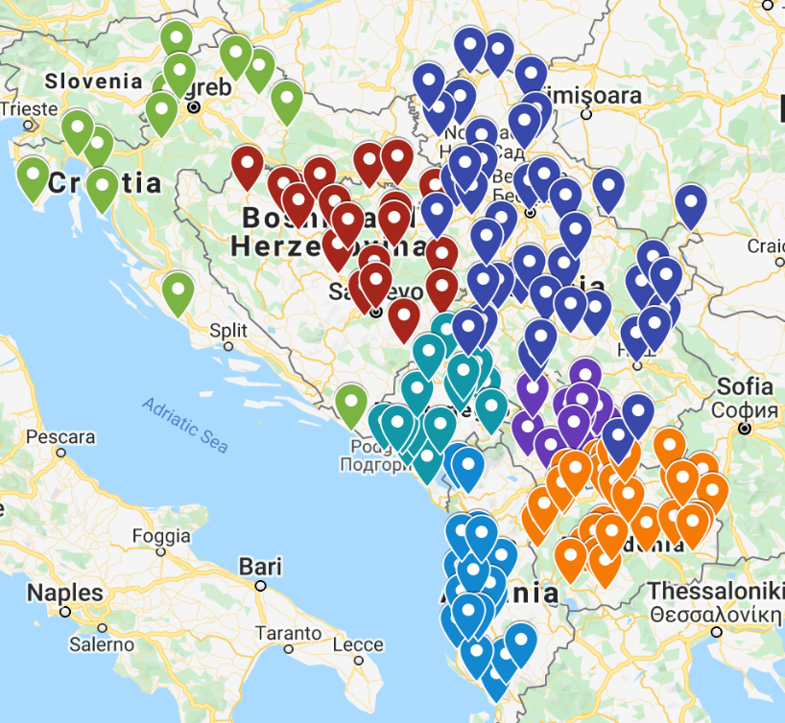
Lessons learned from municipalities using the Municipal Finance Self-Assessment (MFSA) to assess the potential impact of COVID-19 on local government finances
Tamara Nikolic, WB
Marjan Nikolov, CEA
Marina Jandrevska, Municipality of Kisela Voda

Slide 2
What is MFSA?
The MFSA is a tool developed by the World Bank to help cities assesses their financial health and identify actions to mobilize more local financial resources, prioritize public spending, manage and maintain public assets, strategically program investments, and access external financing.
The self-assessment is a toolkit used to:
Analyze the financial situation in a systematic manner
Invites partners to read and understand LSG financial data
Platform to understand and assess the financial situation
Helps in preparation of an Action Plan for improvement of financial management
Planning has no alternatives
Sometimes political wish is difficult to avoid
But planning have no alternative as a tool to manage risks at least
Improve of financial management (what projects in the Action Plan)
Expenditures (expenditure reviews, cost management and cost of services)
Revenues (widening tax base and change of methodologies)
Intergovernmental relations (increase autonomy, (un)conditional transfer shares, more transparent capital transfers from central government’s budget programs)
Borrowing (PPP, credit rating, procedures and consents from central government)
Management (budget planning, evaluation and monitoring, procedures, fiscal transparency)

Slide 3
Scenarios-building was used to assess the scale of the COVID-19 related impact to the local finances in LSGs and
Provide platform for introducing short-term to mid-term actions for the LSGs to mitigate the impact of the COVID-19 context on the LSGs finances and public services provision.
Municipality | Impact on net operating margin 2020FY (% of current revenues in FY2020. Range depending on scenario optimistic-pessimistic) | Impact on net operating margin 2021FY (% of current revenues in FY2021. Range depending on scenario optimistic-pessimistic) | Additional notes
Gazi Baba | 12%-14% | 6%-7% | No need for additional budgetary support but it would require adjusting the key revenues and expenditure programs
Kisela Voda | 8%-9% | 3%-4% | From FY2018 the unpaid liabilities have decline rapidly, thus in FY2019 ended with MKD 75mln. thus, for the first time since 2012 the amount of unpaid liabilities was smaller than cash reserves from the previous year.
Tuzla |  |  | Adopted supplementary 2020 budget, however analysis has found that there is a need to prepare a new supplementary budget.
Banja Luka | 13%-19% | 15% | Want to keep the investment level and to issue muni-bonds
Budva | 20%-27% | 15%-20% | No need for additional budgetary support but it would require adjusting the key revenues and expenditure programs
Shkodra | 0%-5% | 2%-5% | Mitigation of possible pressure on municipal financial sustainability would require interventions and measures both at national and local level, to face and handle the [unexpected] impact of COVID-19 crisis
Experience in using MFSA as a tool to assess the COVID-19 impact on LSG finances

Slide 4
Some of the recommendations
Procurement. Make an inventory of the most essential public procurement needs and limit non-essential procurement to divert the available financial resources towards the most essential services and procurements.
Increase own source revenues. Find additional revenue sources (grants and donations).
Control of expenditures. Reallocation of expenditures for higher priority projects and activities.
Unpaid liabilities. Establishing dynamics for timely payment of liabilities so that the issuance of work orders will depend on the inflow of funds in the budget.
Subsidy for taxpayers. Possibility for postponed payment and payment in installments of the tax due in order to keep the economic activity. Providing additional advantages and incentivizing those taxpayers who pay local taxes and charges before the due date.
Cost of service delivery. Evaluate service delivery cost, as well as operating efficiency of utility companies and local service providers.
Maintain and prioritization of capital projects. Accelerate the large scale infrastructure projects and capital investments. Prioritize the Capital investments plans.
Coordination with central authorities. Exchange of data with the national authorities on unemployed and social welfare beneficiaries to provide additional support if need it. Closely monitor the risks from the recurrence of the COVID-19 crisis and develop further and additional emergency budget scenarios (e.g. by using the MFSA tool).
CSO sector can be powerful instrument during the COVID-19, in providing services and support for categories in need. Municipalities should nurture this sector and keep it alive.

Slide 5
Conclusions
Strategy: Proper risk management strategies
PFM: Mandatory budget reserves and cash reserves (mostly due to low capital realization)
Policy: LSG with higher than average OSR in total revenues e.g. “rich” LSGs vs. “poor” LSGs
Communication: Property tax-regressive, deferred tax payment is not the same as tax foregone thus, does not really affect the tax morale/tax behavior of taxpayers e.g. those who pay will pay anyway. Conclusion is that on average if there is a decline of property tax payment this will mostly be due to the income effect rather than tax behavior effect.
Scope: Communal enterprises and LSGs

Slide 6
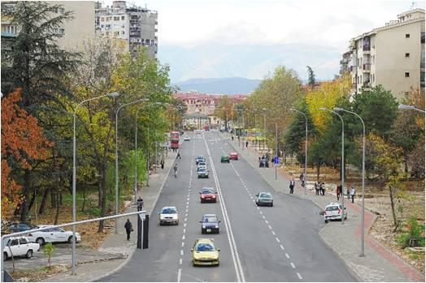
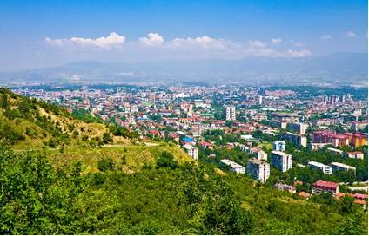
COVID-19 impact on local economy in Kisela Voda
Potential Losers (Manufacturing industry, Wholesale and retail trade, Construction & Real Estate, Education)
Potential Winners (Medical supplies & services, Food processing & supermarkets, E-commerce, ICT)
Local business less income job losses lower household and business spending
Lower external demand from the EU negatively affect the economy, especially the exports
Recommendations:
Maintaining a good balance between expenditures and available resources (revenues in short, medium and long run)
Further increase of own-source capital revenues (land development fee)
Further increase of own-source capital revenues (revenues from selling assets)
Faster completion of the legalization process
Tax morale increase of the taxpayers
Control of expenditures
Unpaid liabilities
Find additional revenue sources (grants and donations)

Slide 7
MFSA Resources
Resources on UPP and MFSA:
http://www.seecities.eu/seecities.eu/MFSA
MFSA Learning program:
https://olc.worldbank.org/content/municipal-finances-learning-program-local-governments-self-paced
Municipal Finances: A Handbook for Local Governments
https://openknowledge.worldbank.org/handle/10986/18725
Better Cities, Better World: A Handbook on Local Government Self Assessment
https://openknowledge.worldbank.org/handle/10986/32120

