Slide 1
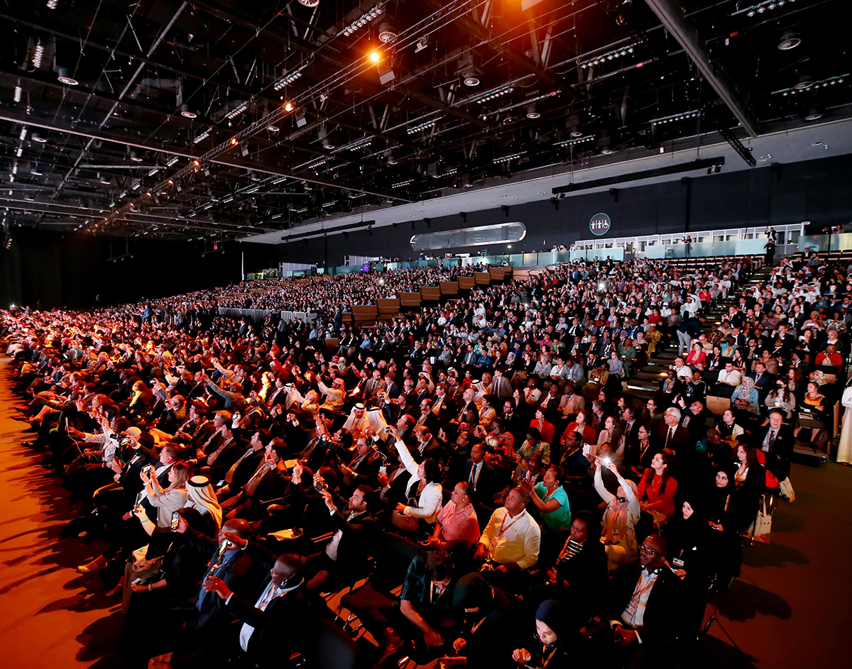
WUF11 briefing for Member States and partners:

Slide 2
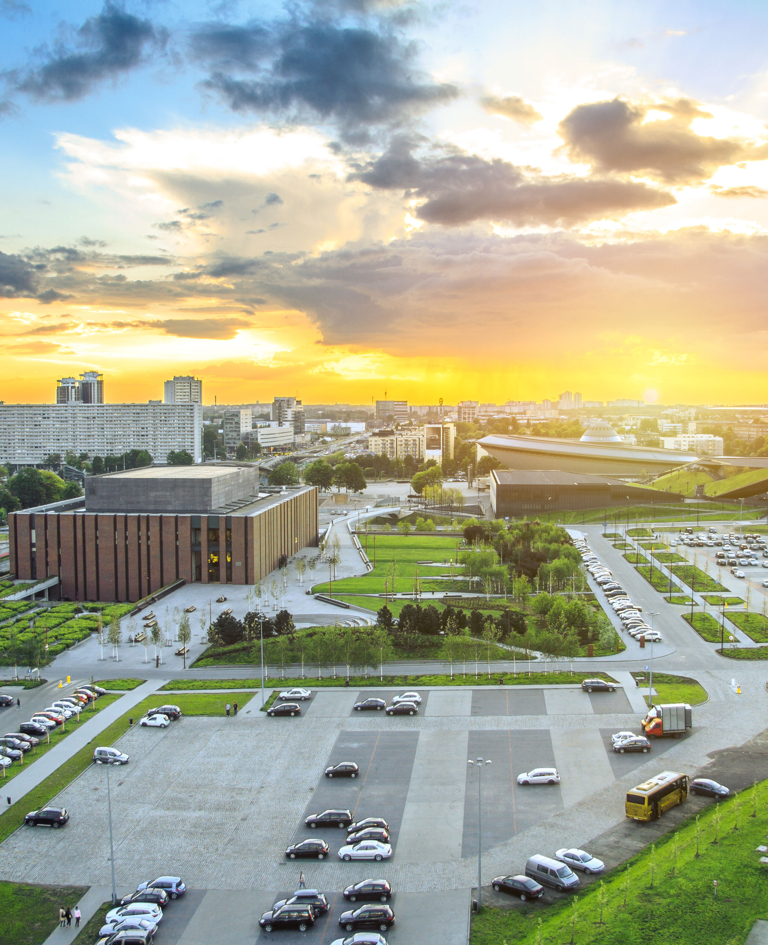
Welcome to WUF11!
The Eleventh Session of the World Urban Forum (WUF11) will be held in Katowice, Poland
26-30 June 2022
Transforming Our Cities for a Better Urban Future
The World Urban Forum is the largest convening of sustainable urbanization stakeholders, thought leaders and policy actors. In June 2022, we are excited to welcome more than 10,000 people in virtual and in-person sessions to the city of Katowice, Poland, to explore innovations, solutions and policy opportunities on the urban transformation agenda as part of the decade of action to achieve the SDGs.
WUF11 will also feature the launch of the World Cities Report 2022 Envisaging the Future of Cities.
Notes:
As I focus on WUF11, I would like to highlight the advanced stage of preparations and thank the host county and city for the fruitful and collaborative joint work.
UN-Habitat is pleased to confirm the dates for June 26-30 June 2021 and look forward to meeting you all in Katowice next year.
Katowice is a wonderful example of urban transformation and regeneration, a story that will become globally known at WUF11 and inspire many other cities.
WUF theme is aligned with the World Cities Report 2022 Envisaging the Future of Cities.
Set the scene and agenda for the Dialogues – data / findings
WCR will inform WUF11 Concept Note and the overall WUF11 Programme
Set a framework for policy and action:
Inform WUF11 Outcome Document – (aligned with the High Level Meeting on NUA implementation)

Slide 3
A New Look for WUF
WUF11 official website launched January 2022 www.worldurbanforum.org
Notes:
Entry points for collaboration with SAGE (short-term):
WUF11 Running – advise on stakeholder engagement and composition of the Advisory Group
Review and input to WUF11 Concept Paper, programme and related knowledge projects
Support in early mobilization of stakeholder groups and constituencies once the WUF11 theme is defined
NUF 2.0 (2021- 2023) – Input in the workplan, advise on the roll out, with focus on constituency building towards WUF11
Inputs to Abu Dhabi Declared Actions (Report of Implementation by end of the year) – support to mobilize stakeholders and provide inputs
Special focus on the Outcome Document – early preparations and mobilization of stakeholders

Slide 4
On the Agenda at WUF11: Our Programme
Programme sessions
External leadership through calls for proposals
The Dialogues identify critical dimensions of the New Urban Agenda, to steer policy and practice. They provide a platform to explore connections and linkages between global agendas and locally led action to transform cities and urban settlements
Stakeholder
Thematic
ASSEMBLIES
DIALOGUES
[6]
NETWORKING EVENTS
TRAINING
EVENTS
ROUNDTABLES
[max 14]
SPECIAL SESSIONS [max 14]
THEMATIC ROOMS:
ONE UN
VOICES FROM CITIES
SDG IN ACTION
URBAN LIBRARY
URBAN CINEMA
Notes:
This slide is just to provide an overview of the WUF Programme
And this is in anticipation of question that may be raised on certain topics which may out of
There are two main types of events
Within the events led by UNH – Two main categories
While the dialogues are the most important – they are not the only ones

Slide 5
On the Agenda at WUF11: Linkages and Synergies
Dimensions of the transformation agenda (and Dialogues) :
Background Paper
1. Equitable urban futures
2. Greener urban futures
Background Paper sets the tone for debate and discussion, including sharing of best practice for replication, scale and adaptation to different contexts
3. Innovation and technology
4. Future urban economy and finance
5. Urban planning and governance
background paper has been circulated to Member States and partners for feedback
6. Building urban resilience
Notes:
Dialogues are high-profile events to debate on policy recommendations and focus on the attention on policy action areas identified in the strategic delivery of the New Urban Agenda to achieve the SDGs.

Slide 6
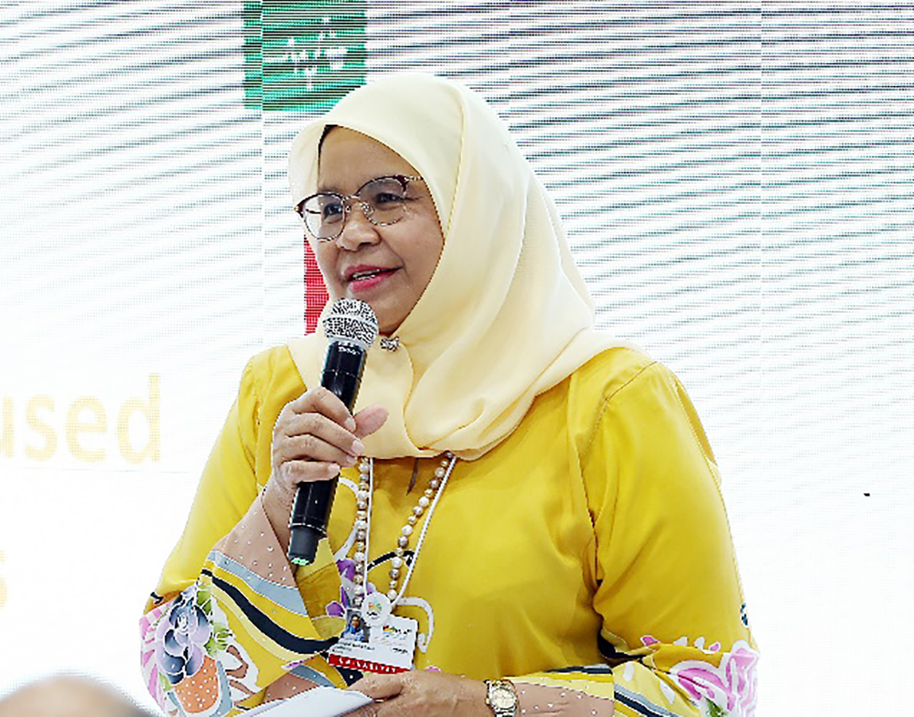
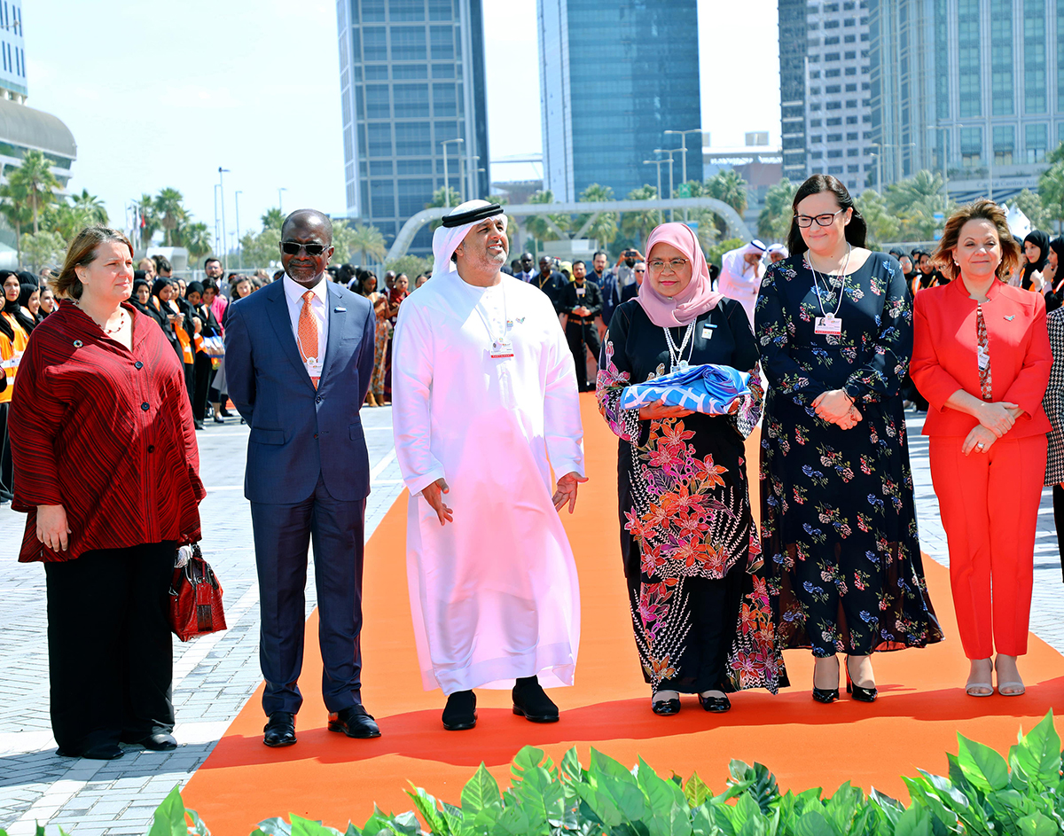
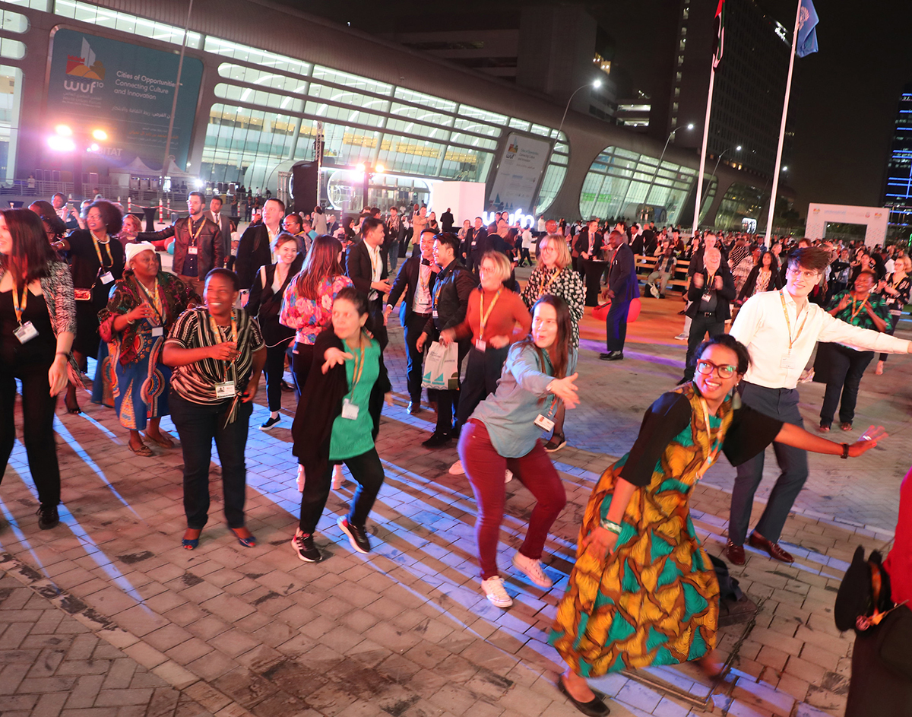
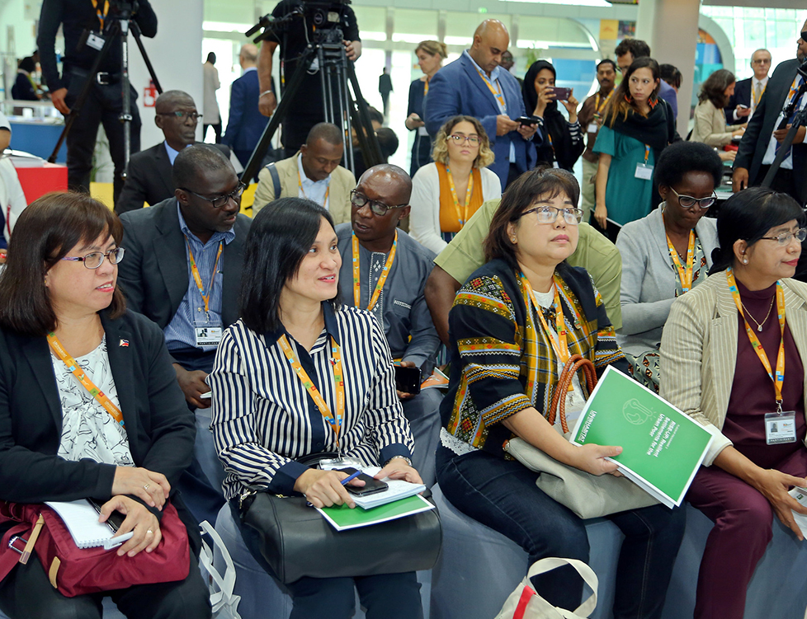

Slide 7
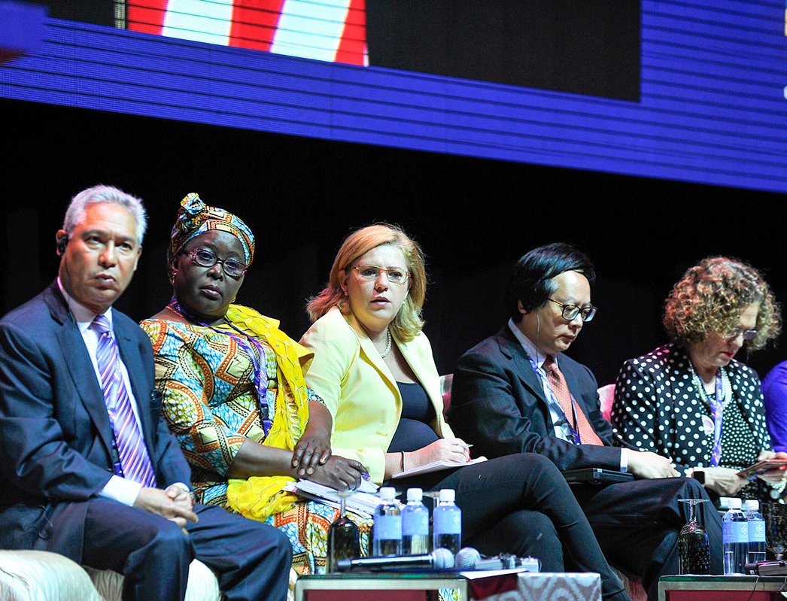
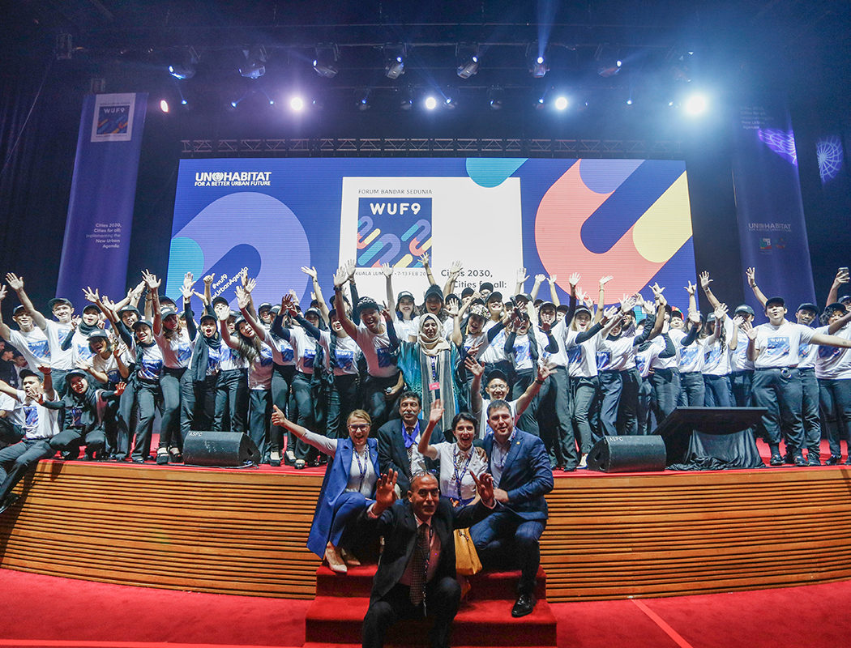
Over the five days of keynote addresses, plenary assemblies, round table discussions and other forums,
UN-Habitat and its host government partners from Poland and the city of Katowice, will curate conversations and encourage sharing of best practices.

Slide 8
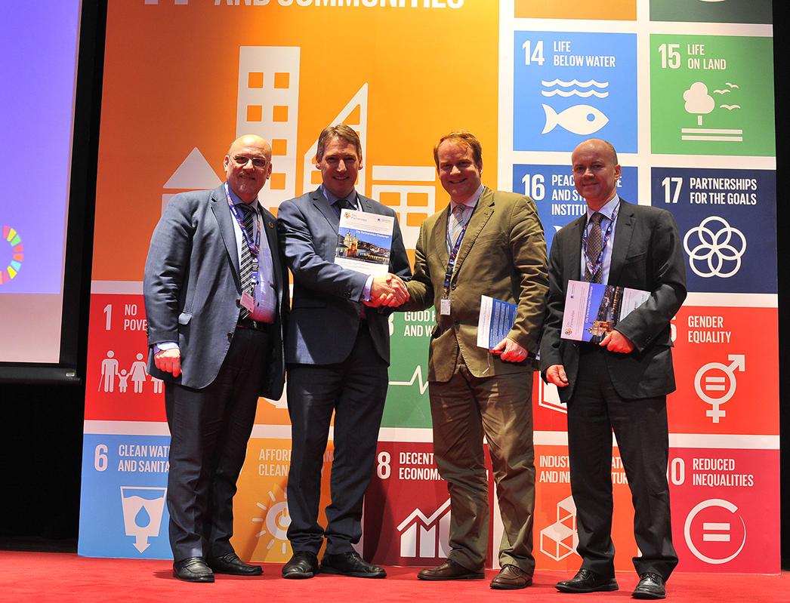
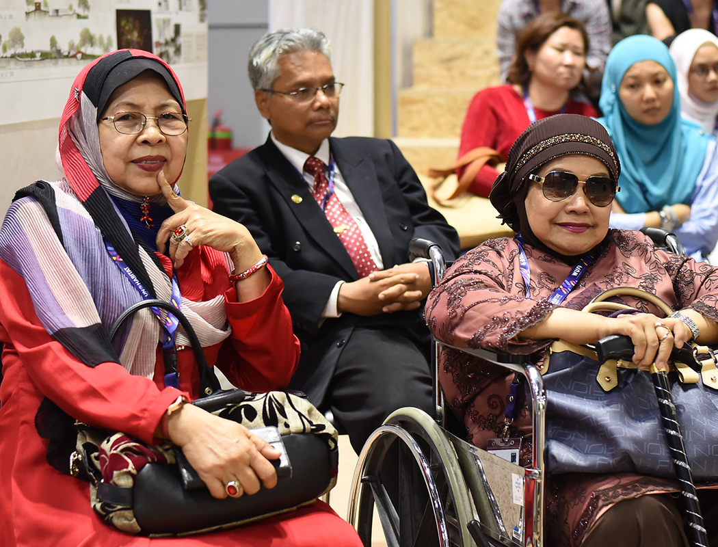
But the heart of the World Urban Forum is its networks of partners. Whether citizen activists, local government representatives, academics or representatives from the private sector, the success of WUF11 depends on you.

Slide 9
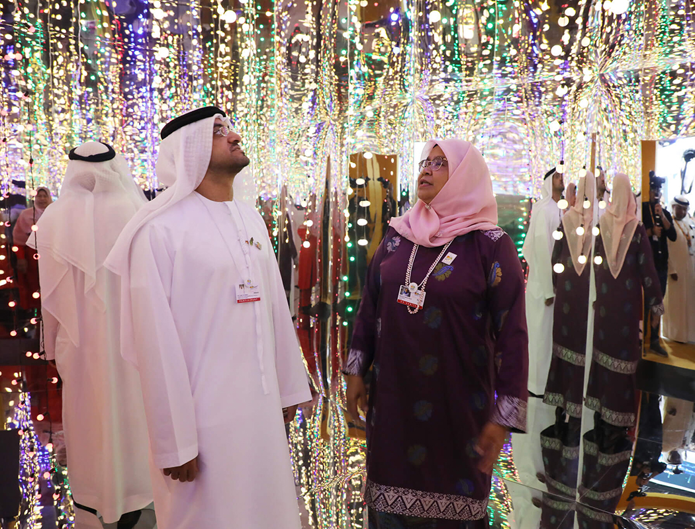
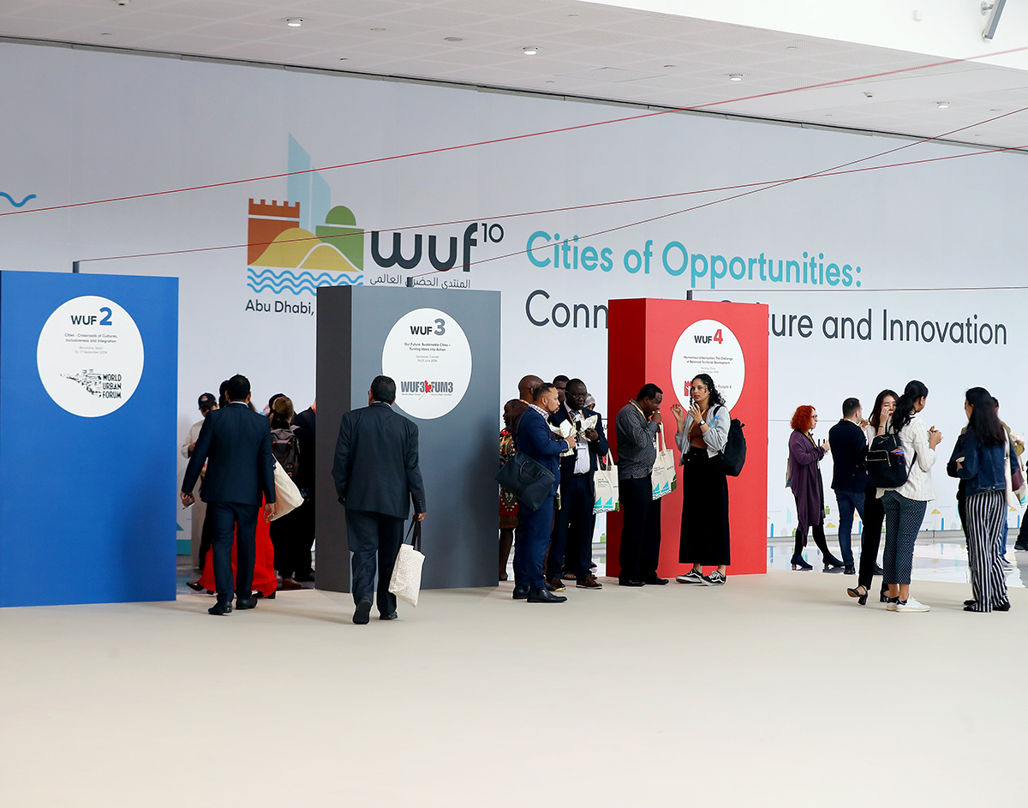
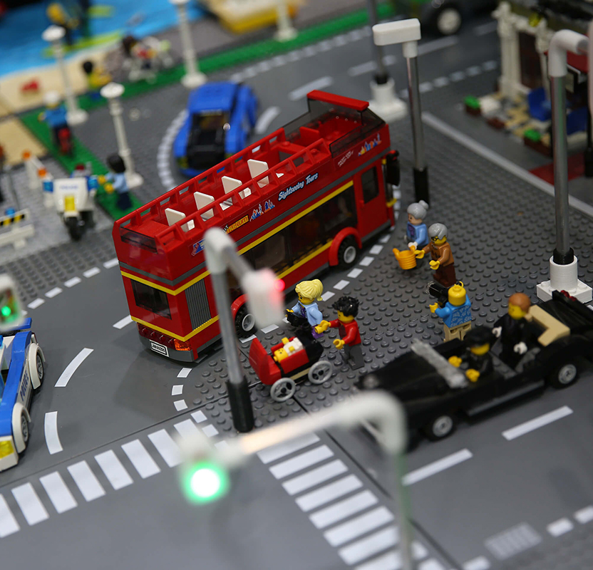
UN-Habitat offers space for partner-led and partner-run events, as well as opportunities to exhibit in our Urban Expo: one of the highlights of every WUF.
The deadline for booking exhibition space is 13 May 2022.

Slide 10
The application process is open from now until 7 March 2022.
Applications must be completed in English.
You must register for WUF11 before you can apply to host an event, as the application form is embedded in the Personal Profile dashboard.
At no time in the application process is any payment expected.
Register now!

Slide 11
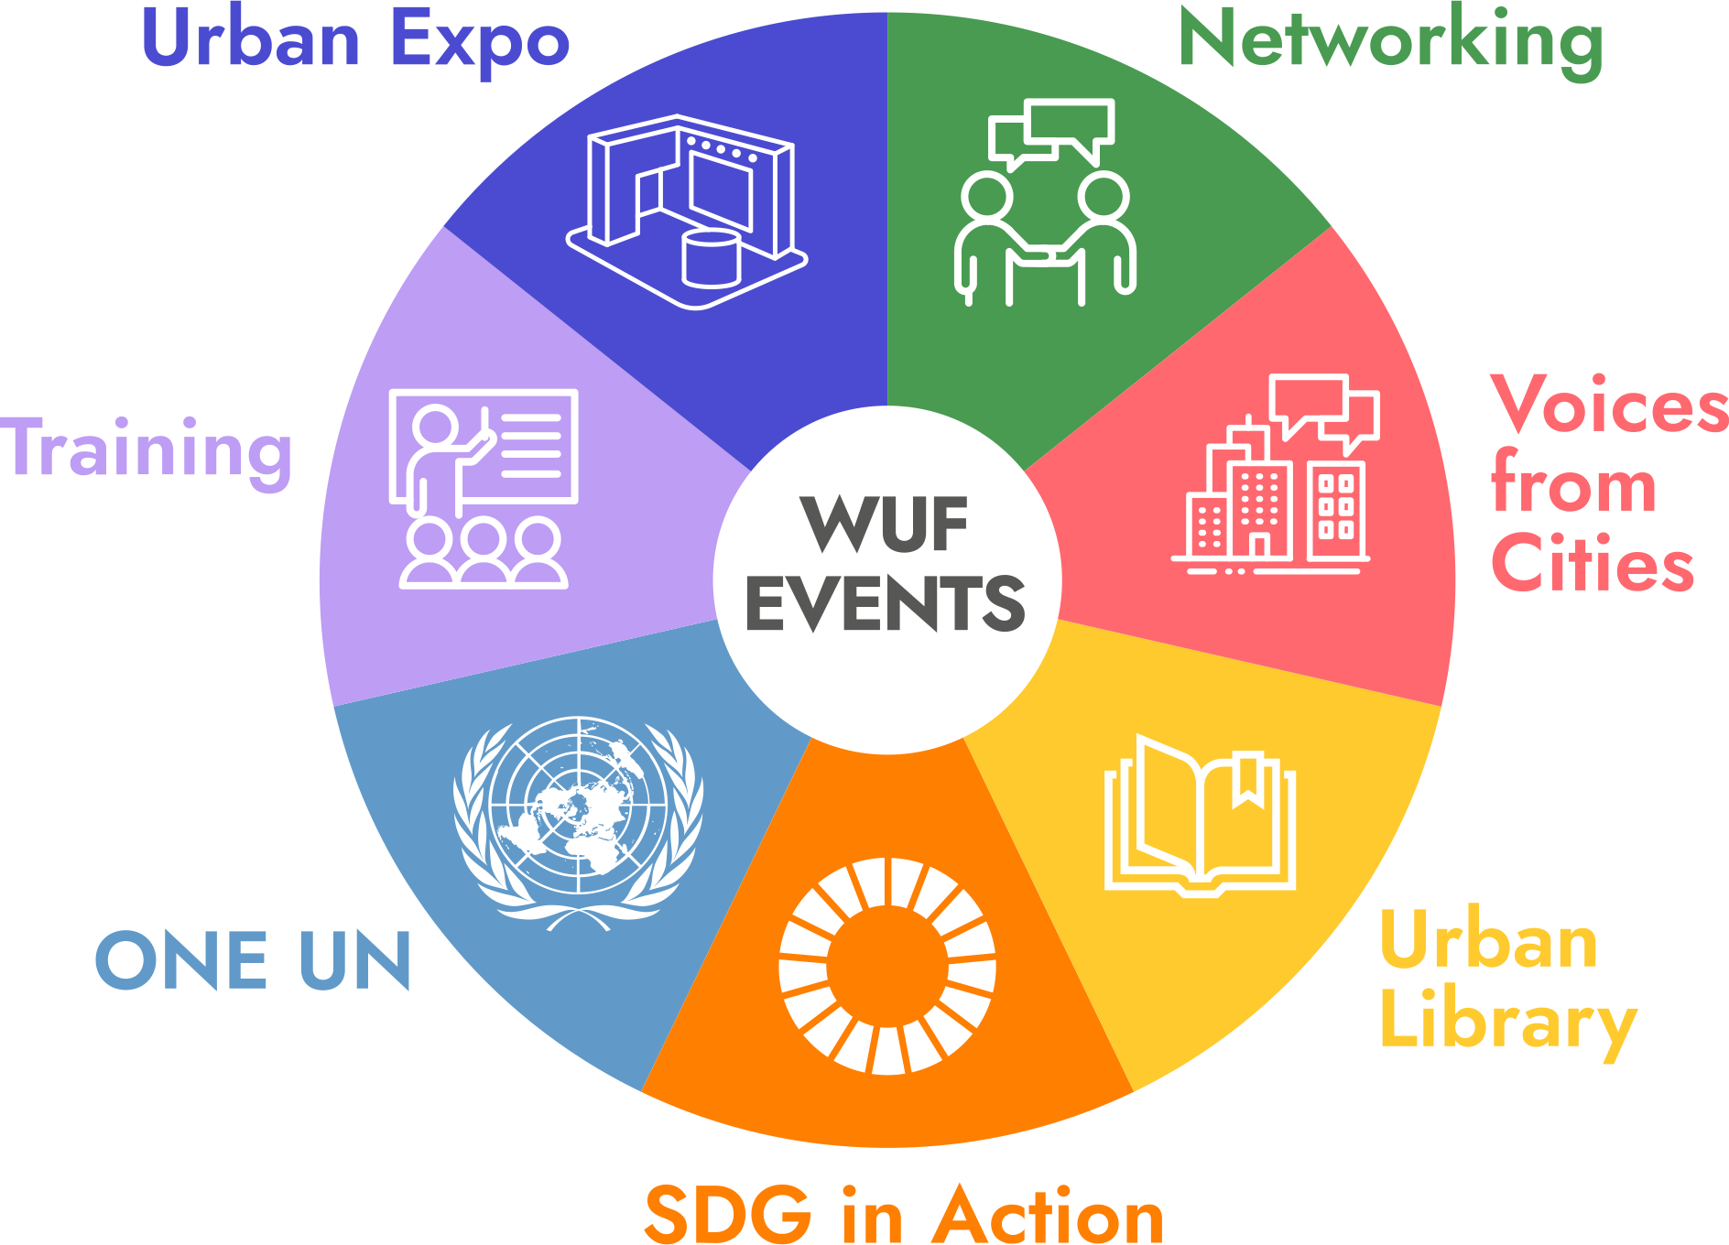
There are seven types of partner-led events at WUF11 and most can accommodate up to 100 people. Hosts can draw on technical support including A/V equipment, projectors and presentation screens. Additional charges are incurred for translation.

Slide 12
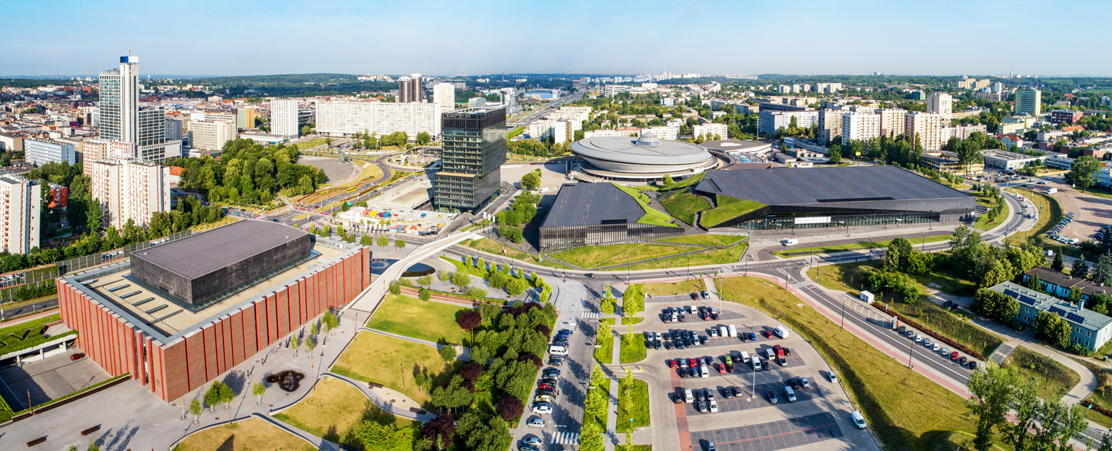
© Shutterstock/Nahlik
Hope to see you in Katowice!

Slide 13
Th
Thank You
for Your Attention !
graham.alabaster@un.org
Head, Geneva Liaison Office
www.worldurbanforum.org
Unhabitat-events@un.org
https://www.unevents.org/Home/Register
(by 7th March 2022)

