Slide 1

UKRAINE HUMANITARIAN SITUATION
9 June 2022

Slide 2




7.8M
311
10
5
People
reached
As of 2 June 2022
Humanitarian
Partners (187 NNGOs)
As of 2 June 2022
Humanitarian
hubs
As of 2 June 2022
Delivered
convoys
As of 8 June 2022
Sources: Clusters and OCHA
Notes:
In the 3rd round of data collection the Health and FSCL cluster partially anonymized some partner names. As a result, we were not able to calculate the distinct number of partner organizations and maintained the number from prior round of 3W.

Slide 3
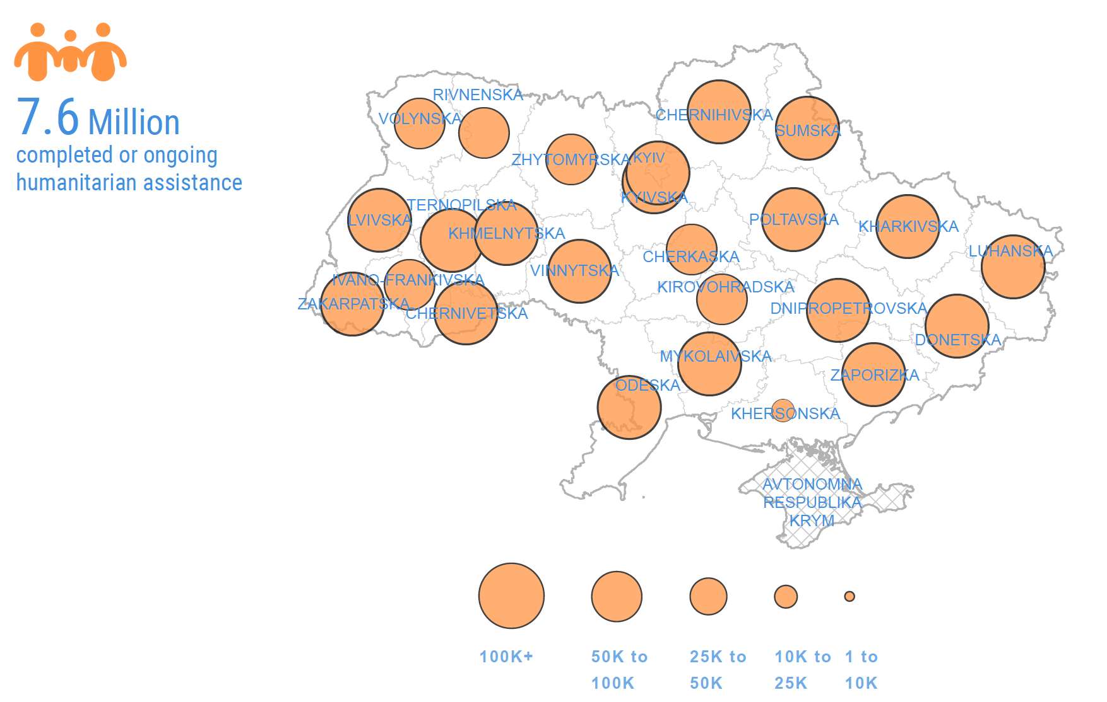
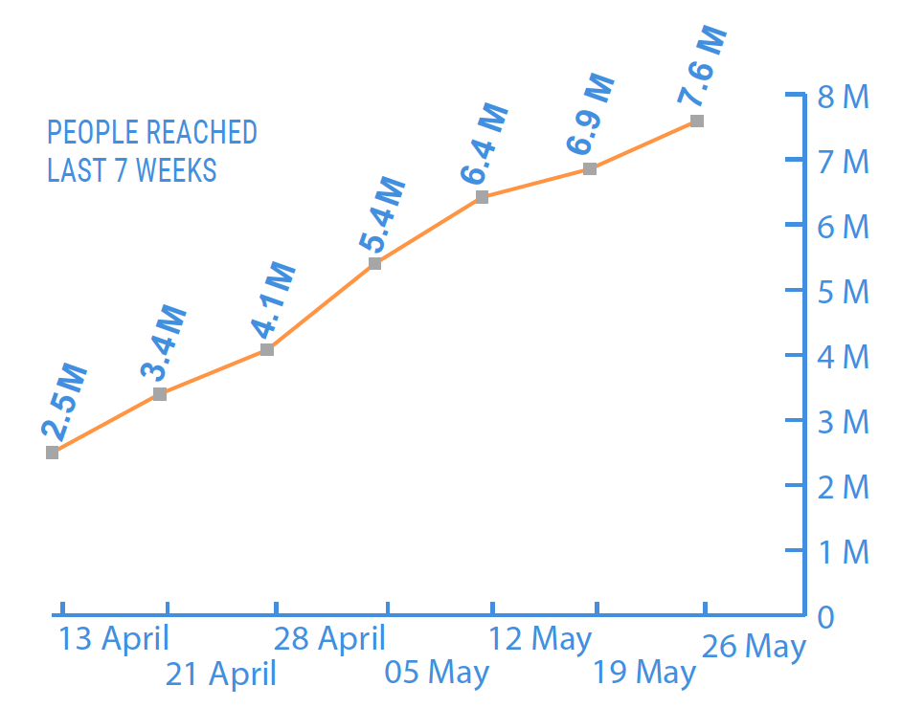
Humanitarian response is scaling up

Slide 4




CHALLENGES
Scope and scale
The war has caused the fastest and largest displacement of people in Europe since World War II.
Access
The main humanitarian challenge is to secure safe access in areas with ongoing fighting.
Logistics
Large geographical area. Attacks on roads and infrastructure, and a lack of drivers or vehicles, hamper transfer of relief items.
Security
The operating environment is highly volatile with attacks on civilian infrastructure, on hospitals, schools and places of shelter.
Notes:
The scope and scale of destruction and displacement is unprecedented in speed and magnitude. More than 6.5M are displaced within the country and 3.6 have crossed into neighboring countries.

Slide 5
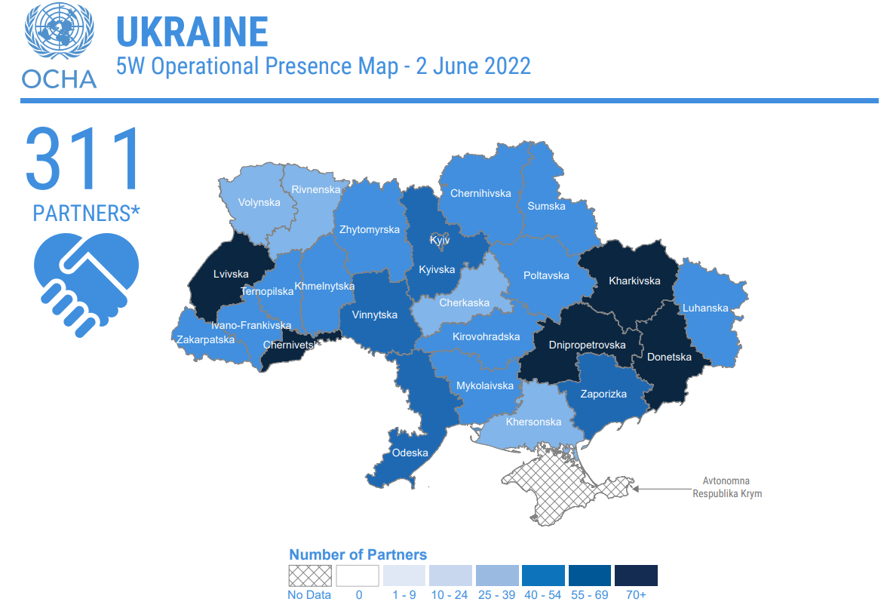
HUMANITARIAN PRESENCE (3W)

Slide 6
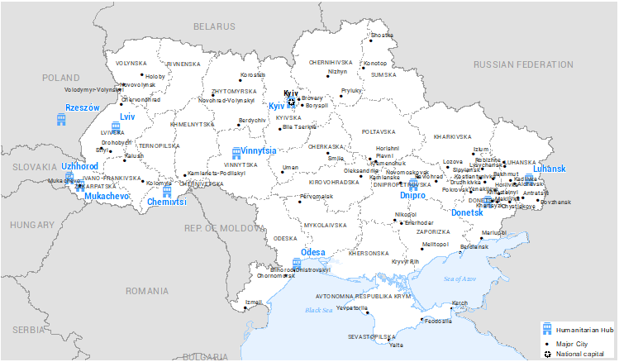
HUMANITARIAN HUBS

Slide 7

CASH
Cash is expected to be the main modality of the response in Ukraine and humanitarian partners are planning to reach 2 million people with $ 600 M in cash over the coming months. As of 7 June, 1.6 million people have been reached with over $200 million.
In-kind, material humanitarian relief will likely remain the preferred modality east of the “contact line” in eastern Ukraine and in most encircled areas for the time being.
2M
People targeted (1.6M people reached)

Slide 8
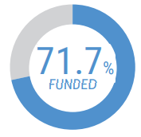


FUNDING – Flash Appeal 2022
15.7M
72%
Funded
$2.2B
requirement
$1.6b received
28%
UNMET
$0.6B funding gap (US$)
People in need
8.7M
Funding required
people targeted
Source: OCHA FTS

Slide 9
UKRAINE HUMANITARIAN FUND
The Ukraine Humanitarian Fund (UHF) is a country-based pooled fund mechanism established in Ukraine in February 2019 to help meet the most critical needs of the conflict-affected population in eastern Ukraine. The funding available to the UHF grew from annual contributions of USD7-12M (2018-2021) to currently over US$ 200M.
It is a tool available to donors to pool their contributions into single, unearmarked funds to enable humanitarian partners to deliver timely, coordinated and principled assistance.
Some $90 million have been allocated from the Fund so far this year.
How to donate: https://crisisrelief.un.org/t/ukraine

Slide 10
Ukraine Private Sector Donations
Over 600 donations by some 400 private sector donors totaling $1.4B
Ukraine Private Sector Donations Tracker: Dashboard (humdata.org)

Slide 11
THANK YOU!

